Slide 1
EtherCAT Topology Diagram In Paper
Real-Time Linux
Robot Control PC (EtherCAT Master)
Slave 1 Servo Drive
Slave 2 Servo Drive
Slave 3 Servo Drive
Slave 4 EasyCAT IO
Limit Switch
-2pcs-
Emergency
Switch
: EtherCAT Connection
: Motor

Slide 2
ACCAS Paper : Experimental Results
T_{period} (µs) | Avg. ± St.D | 1000.017±7.035
 | Min / Max | 870.388 / 1148.032
T_{jitter} (µs) | Avg. ± St.D | 2.125±6.706
 | Min / Max | 0 / 148.032
T_{exec} (µs) | Avg. ± St.D | 11.479±7.039
 | Min / Max | 6.194 / 231.767

Slide 3
Master (Advantech MIO-5272 Embedded Single Board Computer)
CPU |  | RAM |  | Network Card
Intel Core i7-6600U CPU @ 3.2GHz |  | 8GB |  | Intel I219 Network Card (driver: generic)
OS | Kernel + RT_Patch |  | Control Frequency |  | Task Priority | Etherlab Version
Xubuntu 20.04 | 5.10.73-rt54 |  | 1 kHz |  | 98 | v1.5.2
Slaves
Servo Drives |  |  | Custom Slave
Maxon Epos4 50/5 Compact -3 pcs.- |  |  | EasyCAT Custom Slave - 1 pcs.-
PDO Mappings Servo Drives |  |  | PDO Mappings Custom Slave
28 bytes each, TxPDO 14 bytes RxPDO 14 bytes |  |  | 8 bytes, TxPDO 4 bytes RxPDO 4 bytes
Control Frequency |  |  | 1 KHz
Hardware – Software Information

Slide 4
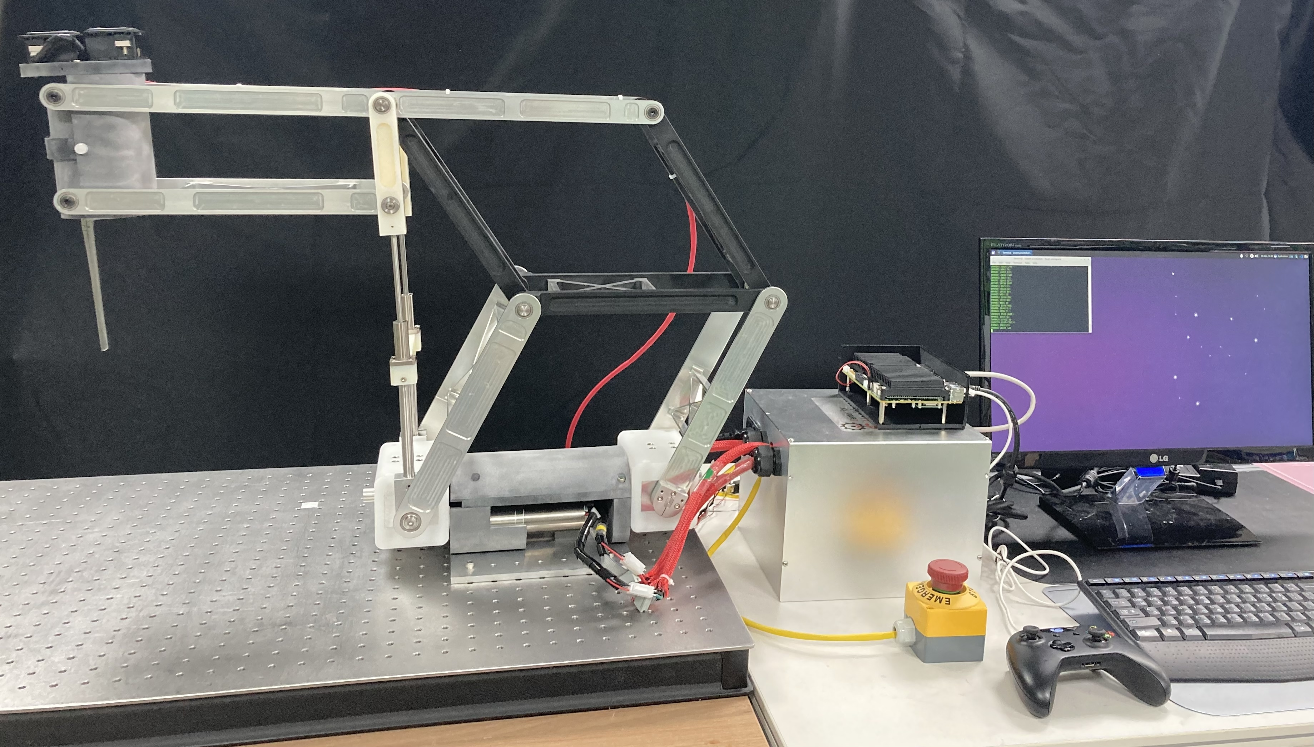
Experimental SETUP

Slide 5
Experimental SETUP
Spine Surgery Robot Mechanism
Generic Monitor Connected to Embedded PC
Advantech MIO- 5272 Embedded PC
Control Box : Includes 3 pcs. Maxon EtherCAT Driver, EasyCAT Slave, PSU and Power Filter
Emergency Stop Button
Xbox Controller

Slide 6
Spine Surgery Robot Mechanism
Generic Monitor Connected to Embedded PC
Advantech MIO- 5272 Embedded PC
Control Box : Includes 3 pcs. Maxon EtherCAT Driver, EasyCAT Slave, PSU and Power Filter
Emergency Stop Button
Xbox Controller

Slide 7
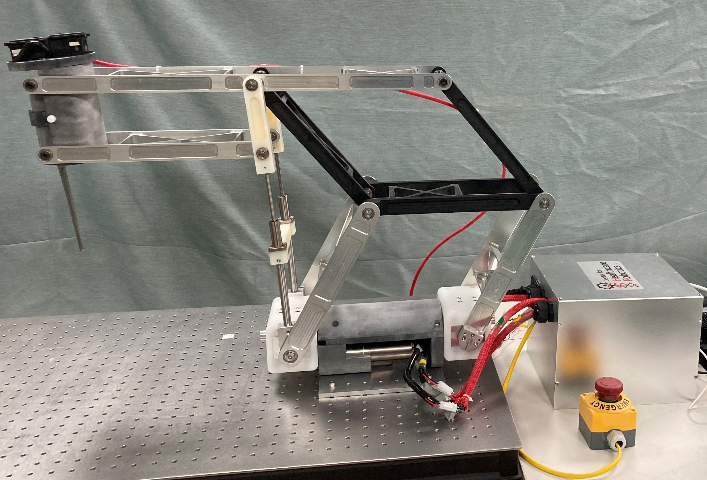
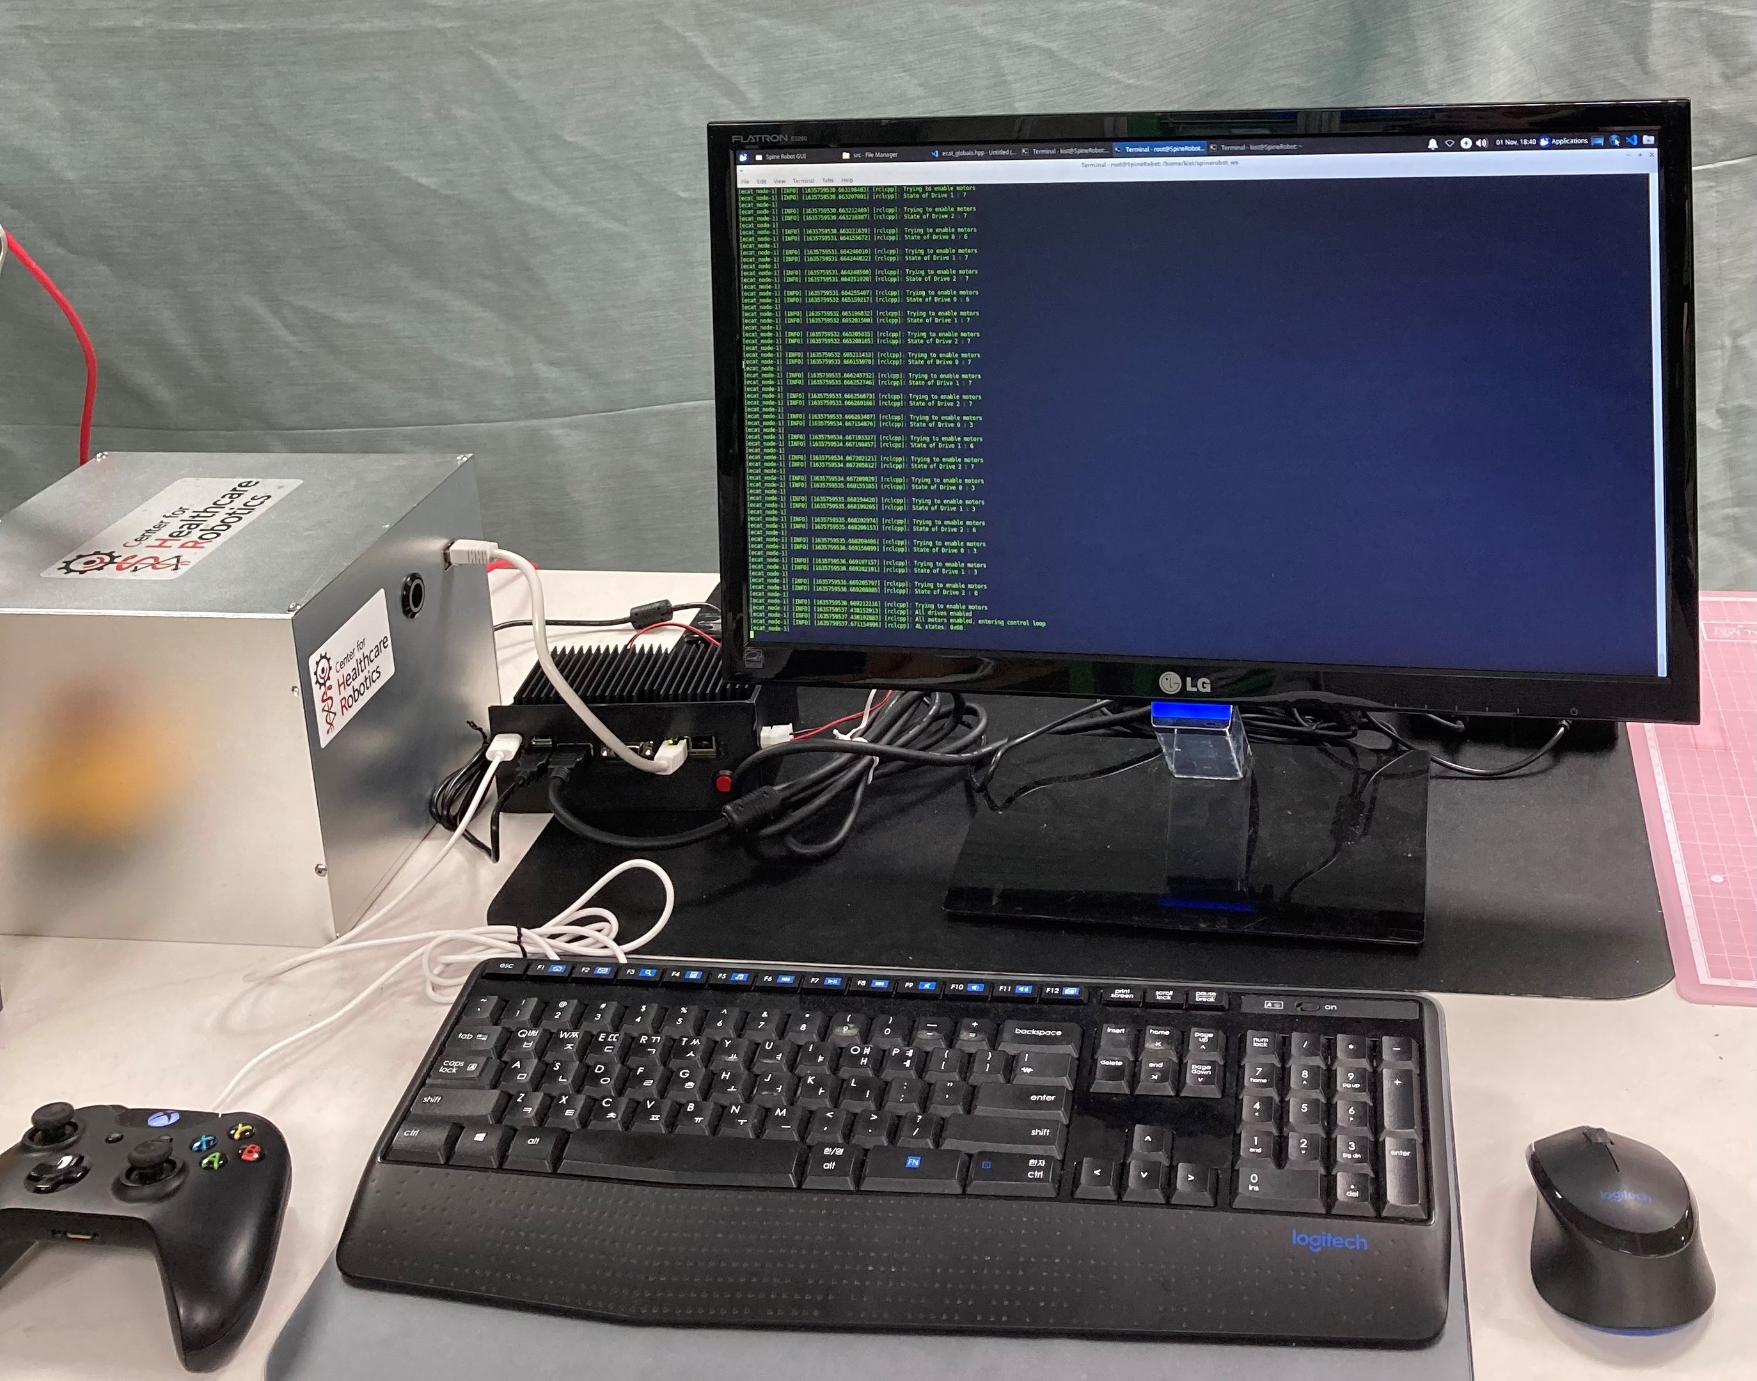

Slide 8
ROBOT CONTROLLER / Initial Diagram
Physical / Electrical communication between sensors and actuators (EtherCAT)
Software Integration of Components
Robot Control PC (EtherCAT Master)
Slave 1 Servo Drive
Slave 2 Servo Drive
Slave n EasyCAT IO
…
Various Sensors
: EtherCAT Connection
ROS2
: Topics and Services
GUI Node
User – Screen
EtherCAT Node
EtherCAT Comm.
Control Node
Control Algorithm
Safety Node
Safety Algorithm

Slide 9
Comparison of Middleware
Software Framework | Component Based | State Machine | Real-time | EtherCAT
Cisst | ⚫ | ⚫ | X | X
Orocos | ⚫ | ⚫ | ⚫ | X
ROS | ⚫ | X | X | ⚫
Our ROS2 | ⚫ | ⚫ | ⚫ | ⚫

Slide 10
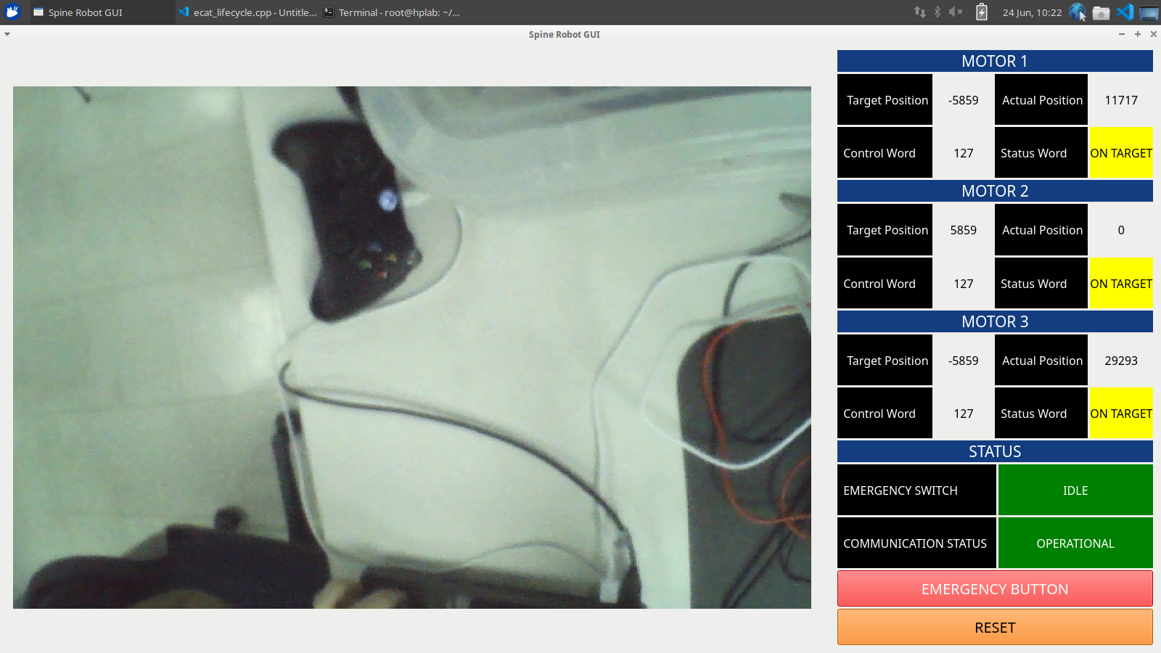
Feedback from
Slaves & Master
Endoscope
camera viewer
Soft Emergency
&
RESET button

Slide 11
Diagram In Paper
Robot Control PC (EtherCAT Master)
Slave 1 Servo Drive
Slave 2 Servo Drive
Slave n EasyCAT IO
…
Various Sensors
Physical Integration
: EtherCAT Connection
: Motor
Real-Time Linux
ROS2
: Topics and Services
GUI Node
User – Screen
EtherCAT Node
EtherCAT Comm.
Software Integration
Control Node
Control Algorithm
Safety Node
Safety Algorithm

